Slide 1
Classifying Threat Intelligence Sentences into MITRE ATT&CK Tactics
AIC211 · AI for Cybersecurity · Project Topic 10
A leakage-aware NLP pipeline: TF-IDF + Linear SVM baseline versus a fine-tuned DistilBERT
16,952
15
0.791
labeled sentences, ATT&CK v20.0
tactics, multilabel
test Macro-F1 (baseline 0.763)
Đoàn Hải Đăng · Chu Văn Tuấn Đạt · Lê Đức Cường · Pruvot Chales · Nguyễn Phúc Thịnh

Slide 2
From threat-report text to ATT&CK tactics
OVERVIEW
Problem
The notebook pipeline
Analysts map free-text threat reports to ATT&CK by hand. It is slow and inconsistent, and a missed mapping hides a detection gap.
0–1
Load ATT&CK v20.0 and build the sentence table
2
Preprocess and block label leakage
Task
3
Group-aware train / validation / test split
One sentence in, a set of ATT&CK tactics out: 15 labels, multilabel. 13.5% of sentences carry more than one tactic.
4–7
Baselines, DistilBERT, thresholds, validation
Example
8–10
Test once, error analysis, security impact
<ACTOR> used ntdsutil to obtain a copy of the victim environment ntds.dit file.
11–13
Explanations, robustness, figures
→ credential-access
AIC211 · AI for Cybersecurity · Topic 10
2 / 18

Slide 3
Data: ATT&CK v20.0 procedure examples
STEPS 0–1 · LOAD AND BUILD
26,690
706
17,563
15
STIX objects in the bundle
active techniques and sub-techniques
procedure examples after filtering
tactics (Stealth and Defense Impairment are new)
How the table is built
Where the sentences come from
Read the STIX bundle, skip revoked and deprecated objects
Take every “uses” relationship that has a description
Map its technique to tactics through kill_chain_phases
Drop texts under 5 words and exact duplicates (17,636 → 17,563)
malware
10,672
groups
4,810
campaigns
1,213
tools
868
AIC211 · AI for Cybersecurity · Topic 10
3 / 18

Slide 4
Cleaning that blocks label leakage
STEP 2 · PREPROCESSING
Five operations
Before and after (illustrative)
APT29 used ntdsutil to copy the AD database (T1003.003) and upload it to http://10.1.1.5/x
Remove citations, markup and technique IDs such as T1059
Mask the actor: group or malware name → <ACTOR>
Mask indicators: <URL> <IP> <HASH> <REGKEY> <PATH> <EMAIL>
Merge identical sentences and unite their labels
Flag, do not delete, sentences that contain the technique name
↓
<ACTOR> used ntdsutil to copy the AD database ( ) and upload it to <URL>
16,952
13.5%
unique sentences
have more than one tactic
13.8%
1.9%
contain the technique name
came from more than one source
AIC211 · AI for Cybersecurity · Topic 10
4 / 18

Slide 5
Stealth has 20× more sentences than Reconnaissance
STEP 2 · CLASS DISTRIBUTION
stealth
3,562
Why it matters
discovery
3,337
Macro-F1 is the main metric: every tactic counts equally
Both models use class weighting for rare tactics
The split keeps every tactic in train, validation and test
A sentence can count for several tactics
execution
2,334
command-and-control
2,183
persistence
1,522
privilege-escalation
1,494
collection
1,266
credential-access
887
initial-access
660
defense-impairment
645
resource-development
611
exfiltration
399
impact
397
lateral-movement
376
reconnaissance
181
AIC211 · AI for Cybersecurity · Topic 10
5 / 18

Slide 6
Group-aware split: no source group in two sets
STEP 3 · SPLIT
Train 11,752
Val 2,600
Test 2,600
509 groups · 69.3%
91 groups
90 groups
1,071 sources merged into 690 groups with union-find; groups assigned greedily, rarest tactics first, seed 42.
Why group-aware
Checks printed by the notebook
Sentences of one malware family are written alike
A random split would leak near-duplicates into test
Scores would look better than they are
Group overlap between sets: 0
Near-duplicates (cosine ≥ 0.9): 0.4% val, 0.6% test
14.8% to 17.7% of each tactic lands in test
Reconnaissance: 117 / 32 / 32 sentences
AIC211 · AI for Cybersecurity · Topic 10
6 / 18

Slide 7
Baselines: TF-IDF with a linear classifier
STEP 4 · BASELINES
Validation Macro-F1
Setup
One binary classifier per tactic (one-vs-rest)
Logistic Regression C=10, Linear SVM C=0.5
Balanced class weights
No tactic predicted: take the top-scoring one
Trains in about 15 seconds
LR, word 1–2 grams
0.753
SVM, word 1–2 grams
0.762
LR, word + char
0.762
SVM, word + char
0.775
Best baseline: Linear SVM with word 1–2 grams plus character 3–5 grams
AIC211 · AI for Cybersecurity · Topic 10
7 / 18

Slide 8
Fine-tuned DistilBERT, thresholds kept at 0.5
STEPS 5–6 · DISTILBERT AND THRESHOLDS
DistilBERT setup
Threshold tuning (validation Macro-F1)
Model
distilbert-base-uncased
Default 0.5
0.818
Output
15 sigmoid probabilities
Tuned, optimistic
0.824
Loss
Weighted BCE, weight √(neg / pos)
Optimizer
AdamW, lr 5e-5, 10% warmup
Tuned, honest CV
0.813
Training
5 epochs, batch 32, 128 tokens
Tuned on one half and scored on the other half, the result falls below the default. Rare-tactic thresholds overfit, so we keep 0.5.
Selection
Best epoch on validation Macro-F1
AIC211 · AI for Cybersecurity · Topic 10
8 / 18

Slide 9
DistilBERT leads on every validation metric
STEP 7 · VALIDATION
Baseline (Linear SVM)
DistilBERT
Validation scores
Largest gains per tactic
Micro-F1
0.811
Impact
+0.162
0.835
Reconnaissance
+0.103
Macro-F1
0.775
Resource dev.
+0.089
0.818
Exact match
Exfiltration
+0.087
0.720
0.780
Better on 13 of 15 tactics
AIC211 · AI for Cybersecurity · Topic 10
9 / 18

Slide 10
On the test set DistilBERT still beats the baseline
STEP 8 · FINAL TEST (USED ONCE)
Baseline (Linear SVM)
DistilBERT
Test scores (2,600 sentences)
95% bootstrap interval of Macro-F1
Micro-F1
Baseline
0.805
DistilBERT
0.835
Macro-F1
0.70
0.775
0.85
0.763
Gain +0.028, interval +0.010 to +0.046, which excludes zero.
0.791
Exact match
DistilBERT right and baseline wrong: 341 sentences. The reverse: 158.
0.710
Without the technique name (2,218 sentences): Macro-F1 0.770 vs 0.743.
0.781
AIC211 · AI for Cybersecurity · Topic 10
10 / 18

Slide 11
DistilBERT improves test F1 on 13 of 15 tactics
STEP 8 · PER-TACTIC F1
Baseline (Linear SVM)
DistilBERT
discovery (n=501)
0.931
command-and-control (n=330)
0.875
stealth (n=532)
0.853
execution (n=346)
0.840
credential-access (n=148)
0.831
privilege-escalation (n=236)
0.822
persistence (n=238)
0.801
collection (n=193)
0.784
lateral-movement (n=66)
0.767
exfiltration (n=60)
0.762
defense-impairment (n=101)
0.754
initial-access (n=109)
0.754
resource-development (n=94)
0.730
impact (n=60)
0.724
reconnaissance (n=32)
0.633
AIC211 · AI for Cybersecurity · Topic 10
11 / 18

Slide 12
Errors cluster in multi-tactic sentences and related tactics
STEP 9 · ERROR ANALYSIS
Exact match falls with tactics and length
Most common confusions (test)
1 tactic
0.798
Execution → Stealth
16
2 tactics
0.655
Collection → Discovery
12
3 tactics
0.628
Execution → Priv. Esc.
9
≤10 words
0.861
Stealth → Execution
9
11–20 words
0.775
Priv. Esc. → Execution
8
21–40 words
0.641
Resource Dev. → C2
8
Many confident errors are label noise: labels belong to the technique, not to the sentence. Example: “has abused peer connections to exfiltrate data” is labeled Defense Impairment.
AIC211 · AI for Cybersecurity · Topic 10
12 / 18

Slide 13
A missed tactic is the costly error
STEP 10 · SECURITY IMPACT
Recall per tactic on test (blue: 0.85 or higher)
14.2%
discovery
0.958
command-and-control
0.888
of true tactics missed (434 of 3,046): a possible detection gap
execution
0.870
stealth
0.868
credential-access
0.865
privilege-escalation
0.852
23 per 100
persistence
0.803
exfiltration
0.800
extra labels (597): analyst time to reject them
initial-access
0.789
reconnaissance
0.781
resource-development
0.777
lateral-movement
0.773
60.6%
collection
0.772
defense-impairment
0.772
of errors sit in the 20% least confident sentences (validation)
impact
0.767
AIC211 · AI for Cybersecurity · Topic 10
13 / 18

Slide 14
Occlusion shows which words drive a prediction
STEP 11 · INTERPRETABILITY
Remove one word at a time and measure the drop in the tactic probability.
<ACTOR> enables SMBv1 during execution.
…embed a copy of PsExec within its payload…
lateral-movement (0.96)
execution (0.89)
SMBv1 +0.95
PsExec +0.76, “and” +0.42
One keyword carries almost everything.
Influence is not understanding.
<ACTOR> used ntdsutil to obtain a copy of … ntds.dit file.
<ACTOR> has attempted to collect browser information.
credential-access (0.94)
discovery (1.00)
obtain +0.13, copy +0.10, ntds.dit +0.05
browser +0.01
Many cues, each one small.
Confident but wrong: the official label is collection.
AIC211 · AI for Cybersecurity · Topic 10
14 / 18

Slide 15
Stable under mild noise, typos hurt most
STEP 12 · ROBUSTNESS
Label sets unchanged
Macro-F1 (500 test sentences)
Original
100.0%
Original
0.818
Synonyms
92.8%
Synonyms
0.798
Typos
88.0%
Typos
0.767
Benign sentence
91.4%
Benign sentence
0.799
−0.051
−0.020
−0.019
Macro-F1 with random typos
with synonym replacement
with a benign sentence appended
Mild random changes only: targeted adversarial rewording was not tested.
AIC211 · AI for Cybersecurity · Topic 10
15 / 18

Slide 16
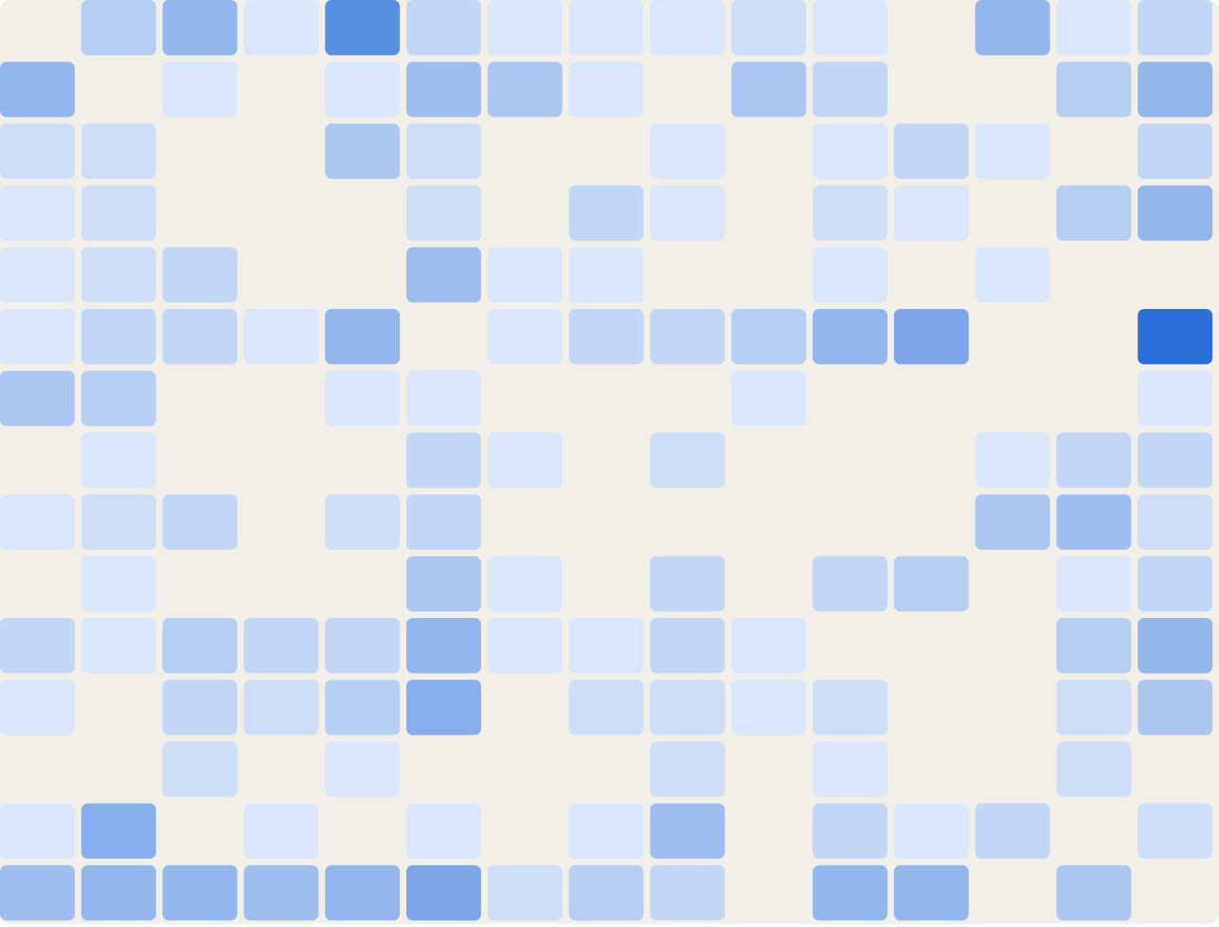
Which tactic is predicted when a tactic is missed
STEP 13 · TACTIC CONFUSION
col
c2
cre
def
dis
exe
exf
imp
ini
lat
per
pri
rec
res
ste
How to read it
Row: the true tactic that was missed
Column: the tactic predicted instead, same order as the rows
Darker cell: more confusions
Execution → Stealth: 16
Collection → Discovery: 12
Execution → Privilege Escalation: 9
Stealth → Execution: 9
collection
command-and-control
credential-access
defense-impairment
discovery
execution
exfiltration
impact
initial-access
lateral-movement
persistence
privilege-escalation
reconnaissance
resource-development
stealth
AIC211 · AI for Cybersecurity · Topic 10
16 / 18

Slide 17
What the notebook shows
FINAL SUMMARY
0.791
0.835
0.781
test Macro-F1 (baseline 0.763)
test Micro-F1 (baseline 0.805)
test exact match (baseline 0.710)
Findings
Limits and next steps
A leakage-aware pipeline for 15 ATT&CK tactics
A contextual model beats TF-IDF on short behavior sentences
Macro-F1 gain +0.028, better on 13 of 15 tactics
Honest CV shows threshold tuning does not help
Technique-level labels make sentence labels noisy
Real reports (APTnotes) are untested; rare tactics have 32–60 test sentences
Always returns a tactic: add a “no tactic” option
Human review stays in the loop
AIC211 · AI for Cybersecurity · Topic 10
17 / 18

Slide 18
Demo: paste a report, see tactics and key words
STEP 14 · DEMO
1
Paste a report paragraph
One or more sentences of threat-report text
<ACTOR> dumped credentials from LSASS memory using a custom tool.
→ credential-access
2
Read the predicted tactics
Each sentence gets tactics with probabilities
<ACTOR> encrypted files on the network shares and demanded a ransom.
→ impact
3
Pick a sentence to explain
Words are highlighted by their occlusion score
The company released its quarterly earnings report on Monday.
→ still gets a tactic: a known limit
python 08_explain_demo.py demo
AIC211 · AI for Cybersecurity · Topic 10
18 / 18

